Slide 1
MongoDB server
Current Stable Release
(4.0-series)
Release Notes for MongoDB 4.0
https://docs.mongodb.com/manual/release-notes/
MongoDB Physical server Requirement
https://github.com/Gs1TestTeam/MongoDB_Task/wiki/1.1-Infrastructure
https://github.com/Gs1TestTeam/MongoDB_Task/wiki/1.4-License

Slide 2
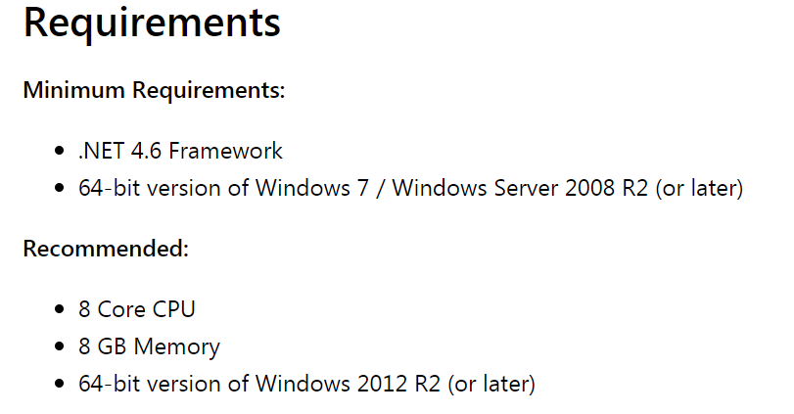
Connectivity
 | MongoDB Cloud | mLab Cloud | On-Premise
Version | 3.4, 3.6, and 4.0 | 3.6 | 4.0
BI Connector | NO (Provide) | Simba MongoDB ODBC Driver - same for any number of installed processors or cores (virtual or physical) - Departmental, enterprise and worldwide licensing available on request. | Mongo BI Connector (Free)
Gateway from Power BI | Free | Free | Free
https://www.simba.com/drivers/mongodb-odbc-jdbc/
Power BI Gateway
https://docs.microsoft.com/en-us/power-bi/service-gateway-onprem#requirements

Slide 3
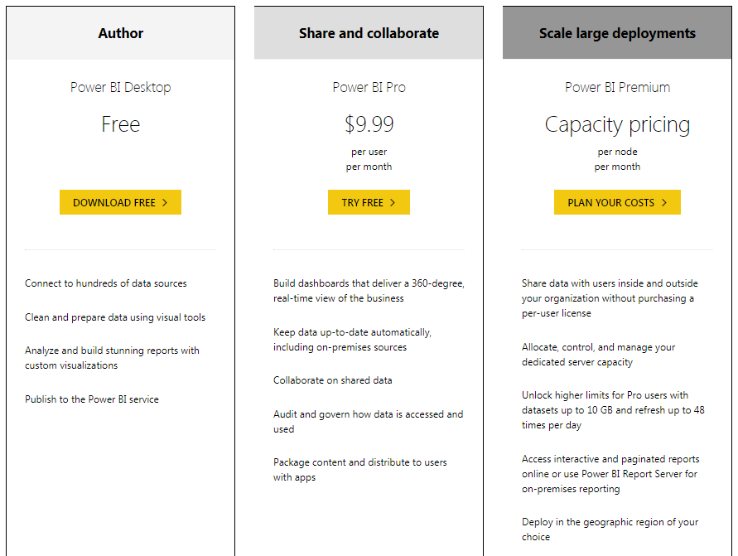
Power BI license & Pricing
https://powerbi.microsoft.com/en-us/pricing/

